Slide 1

Programming for Engineers
BEP2073
>> Slide 5.2
>> Function, method and class (Part 1)
Functions as a type, anonymous functions and list comprehensions codes.

Slide 2
Course Learning Outcome
CLO1 | Outline the operational procedure of programming language.
CLO2 | Outline the object-oriented attribute in the programming flow.
CLO3 | Evaluate the program structure on function, branching and condition.
CLO4 | Develop a programming/syntax solution for chemical engineering case study.
CLO5 | Differentiate between solution error and syntax error for complex engineering case study

Slide 3
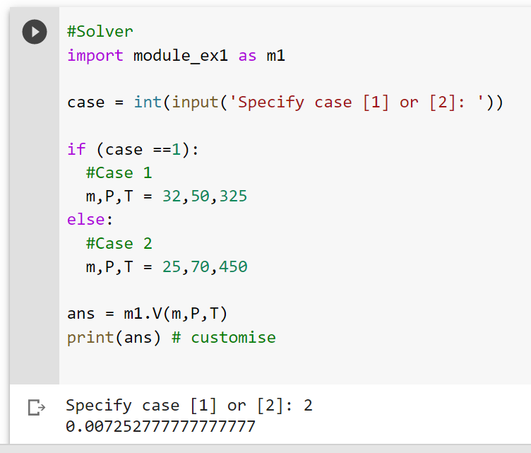




Exercise 1
Develop a module to calculate volume for CO₂ gas at certain mass, pressure and temperature. Given: R = 0.08206 L (atm)/K (mol)
Use each of the equation as a function inside the module
n = m/Mw
V = nRT/P
By using developed module, compute and display result for CO₂ volume in cases below:
Case 1: m = 32 g, P = 50 atm, T = 325 K
Case 2: m = 25 g, P = 70 atm, T = 450 K

Slide 4
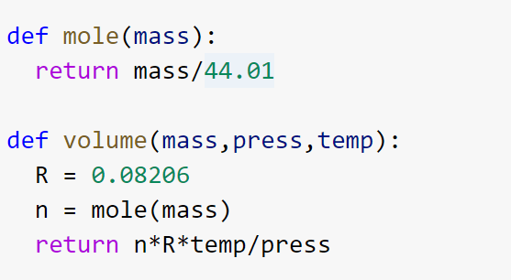
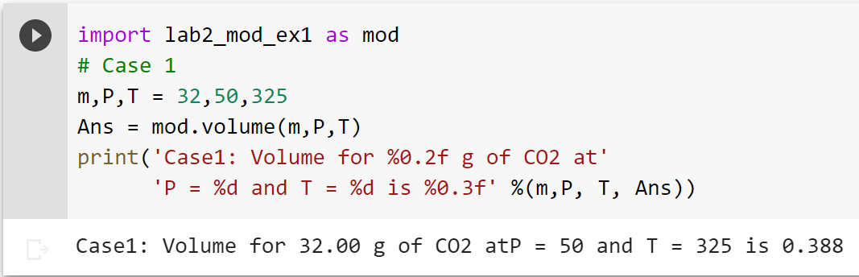
SAVE as lab2_mod_ex1
Create new file and import module

Slide 5
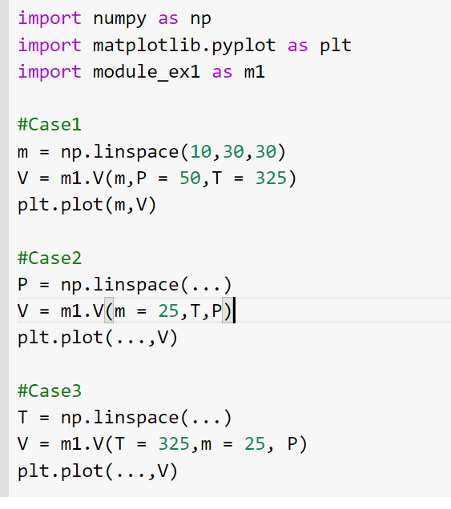








Exercise 2
From Exercise 1 plot CO₂ volume for:
Case 1: m = 10 to 30 g, P = 50 atm, T = 325 K
Case 2: m = 25 g, P = 10 to 70 atm, T = 450 K
Case 3: m = 25 g, P = 70 atm, T = 300K to 750 K

Slide 6












Creating an Object from Class
This will create a new object instance named c.
Then, we can access the data or method of objects using the object name prefix.
Class Car:
doors = 4
instance
c = Car()
>> a = c.doors

Slide 7











Constructors in Python
__init__() function is special function that gets called whenever a new object of that class is instantiated.
This type of function is also called constructors.
class ComplexNumber:
def __init__(self, r = 0, i = 0):
self.real = r
self.imag = i
def get_data(self):
print(str(self.real) + str(self.imag)+'j')
num1 = ComplexNumber(2, 3)
num1.get_data()
[Output]: 2+3j

Slide 8










Slide 9
Example: Create Student List
Using class approach, create an application to store student name.
class Student():
def __init__(self):
self.StudentList = []
def addStudent(self,name):
self. StudentList.append(name)
Obj = Student()
Obj.addStudent(‘FAUZI’)
Hint: Make application for user data entry by Create main menu for
Data Entry

Slide 10





Solution framework
START
DEFINE ListName as empty
while TRUE
false
true
DISPLAY menu
1- Data Entry
2 - Exit
User INPUT as Opt
1
Opt == 1
false
Opt == 2
false
true
true
ADD student name MODULE
BREAK
DISPLAY wrong selection
END
1

Slide 11
EXCEPTIONS
An “exception” is usually defined as “something that does not conform to the norm,” and is therefore somewhat rare.
Example
test = [1,2,3]
test[3]
List of exception: IndexError, ValueError, ZeroDivisionError, and more.
Ref: https://www.programiz.com/python-programming/exceptions
Control Flow Mechanism: raise exceptionName(arguments)

Slide 12
TRY-EXCEPT
This code will work just fine, but it will fail if numFailures happens to be zero.
It would have been better to have try-except
x = 1
y = 2
ratio = x/y
Print(ratio)
try:
ratio = x/y
print('The ratio is’ + str(ratio))
except ZeroDivisionError as e:
print(‘Error: ’,e)

Slide 13

Answer on the following
Case study 1: Using class approach, create an application to store student name.
class Student():
def __init__(self):
self.StudentList = []
def addStudent(self,name):
self. StudentList.append(name)
# display student from list
???
# remove student from list
???
Obj = Student()
Obj.addStudent(‘FAUZI’)
Obj. getStudentList
Challenges:
1. Make application for user data entry
2. Create main menu for
Data Entry
Data removal (Hint: pop() or remove())
Data Display (Option: Pandas)
3.How to avoid error during execution (Hint: Exception)
Final Solution - reflect! How could you improve it? Test it!

Slide 14
Answer on the following
Case study 1: Using class approach, create an application to store student name.
class Student():
def __init__(self):
self.StudentList = []
def addStudent(self,name):
self. StudentList.append(name)
# display student from list
???
# remove student from list
???
Obj = Student()
Obj.addStudent(‘FAUZI’)
Obj. getStudentList
Challenges:
1. Make application for user data entry
2. Create main menu for
Data Entry
Data removal (Hint: pop() or remove())
Data Display (Option: Pandas)
3.How to avoid error during execution (Hint: Exception)
Final Solution - reflect! How could you improve it? Test it!

Slide 15
End

